Slide 1
GIT & GITHUB
Distributed Version Control System (VCS)

Slide 2

What is GIT?
Git is a DevOps tool for source code management—an open-source version control system (VCS) used to handle small to very large projects efficiently. Git is used to track changes in the source code, supporting non-linear development so that multiple developers can work together in near real-time.

Slide 3

What is GitHub?
Github.com is a website that hosts git repositories on a remote server.
• Hosting repositories on Github facilitates the sharing of codebases among teams by providing a GUI to easily fork or clone repos to a local machine.
• By pushing your repositories to Github, you will pretty much automatically create your own developer portfolio as well!.​

Slide 4


CLI & GUI Tools
We can use GIT by using Both methods:
GIT CMD – CLI
SmartGit -- GUI
3. Git GUI

Slide 5
Understand the Git workflow
A Git workflow is a recipe or recommendation for how to use Git to accomplish work in a consistent and productive manner. Git workflows encourage developers and DevOps teams to leverage Git effectively and consistently.
Workflow is a pattern that shows us how the developer and DevOps team Push their code or merge each other Codes.
GIT & GITHUB

Slide 6
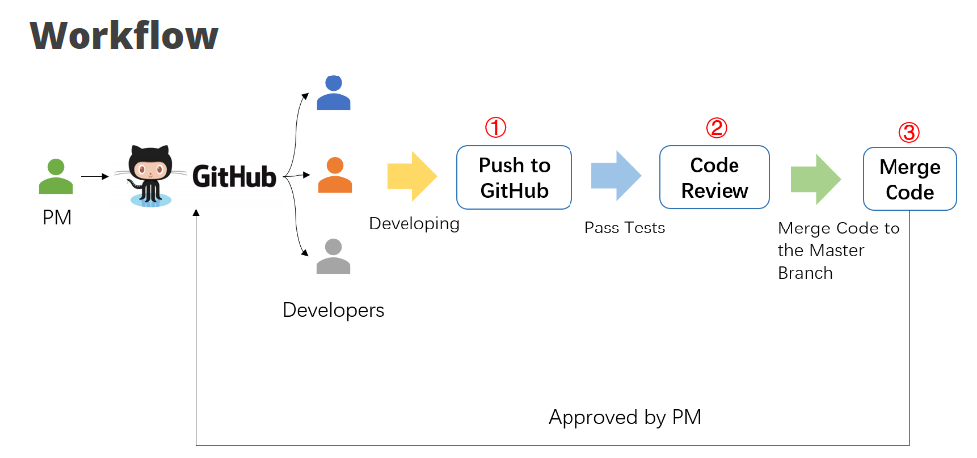
Understand the Git workflow.

Slide 7
How it works
Developers start by cloning the central repository. In their local copies of the project, they edit files and commit changes these new commits are stored locally,
they’re completely isolated from the central repository.
To publish changes to the official project, developers "push" their local main branch to the central repository.

Slide 8
How it works
Develop and main branches
Instead of a single main branch, this workflow uses two branches to record the history of the project. The main branch stores the official release history, and the develop branch serves as an integration branch for features. It's also convenient to tag all commits in the main branch with a version number.
The first step is to complement the default main with a develop branch. A simple way to do this is for one developer to create an empty develop branch locally and push it to the server:

Slide 9
How it works
Feature branches
Each new feature should reside in its own branch, which can be pushed to the central repository for backup/collaboration.
feature branches use develop as their parent branch. When a feature is complete, it gets merged back into develop. Features should never interact directly with
main.
When you’re done with the development work on the feature, the next step is to merge the feature_branch into develop.
GIT & GITHUB

Slide 10
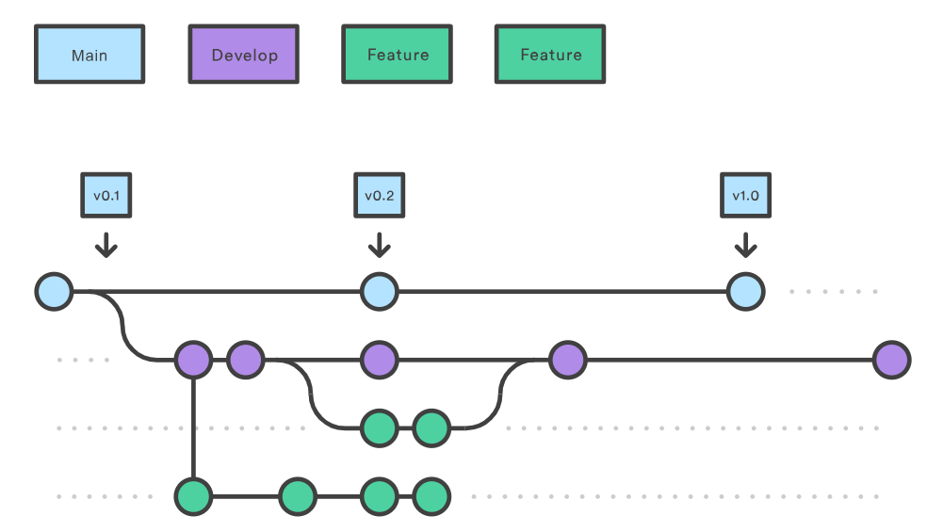
How it works
Feature branches
Note: that feature branches combined with the develop branch is, for all intents and purposes

Slide 11
How it works
Managing Conflicts
If local changes directly conflict with upstream commits, Git will pause the rebasing process and give you a chance to manually resolve the conflicts.
The nice thing about Git is that it uses the same git status and git add commands for both generating commits and resolving merge conflicts.
This makes it easy for new developers to manage their own merges. Plus, if they get themselves into trouble,
GIT & GITHUB

Slide 12
How it works
Release branches
Once develop has acquired enough features for a release (or a predetermined release date is approaching), you fork a release branch off of develop. Creating this branch starts the next release cycle, so no new features can be added after this point—only bug fixes,
documentation generation, and other release-oriented tasks should go in this branch. Once it's ready to ship, the release branch gets merged into main and tagged with a version number. In addition, it should be merged back into develop, which may have progressed since the release was initiated.
GIT & GITHUB

Slide 13
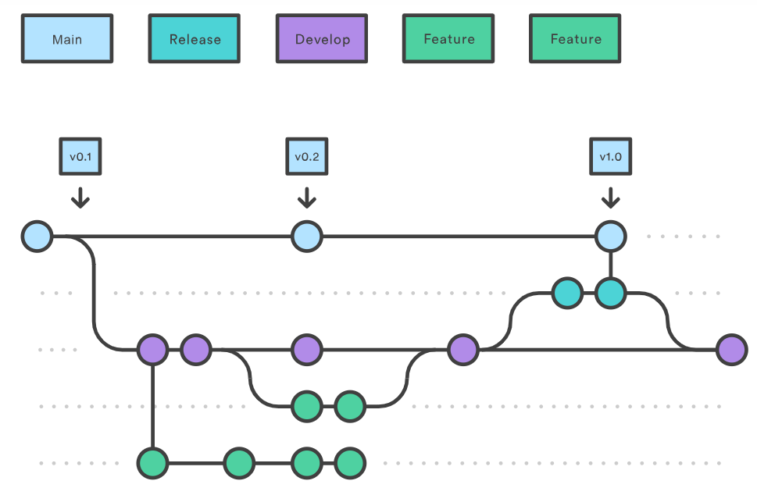
How it works
Release branches:

Slide 14
GIT WORK FLOW EXAMPLE
Here we discussed the Gitflow Workflow. Gitflow is one of many styles of Git workflows you and your team can utilize.
The overall flow of Gitflow is:
1. A develop branch is created from main
2. A release branch is created from develop
3. Feature branches are created from develop
4. When a feature is complete it is merged into the develop branch
5. When the release branch is done it is merged into develop and main
6. If an issue in main is detected a hotfix branch is created from main
7. Once the hotfix is complete it is merged into both develop and main
GIT & GITHUB

Slide 15
Thank you

